Slide 1
Scuttle bug Walking Simulation on Vertical Terrain and Curved Surfaces
Name: Ajay Shankar. K
Scope: 1 credit Master’s projec

Slide 2
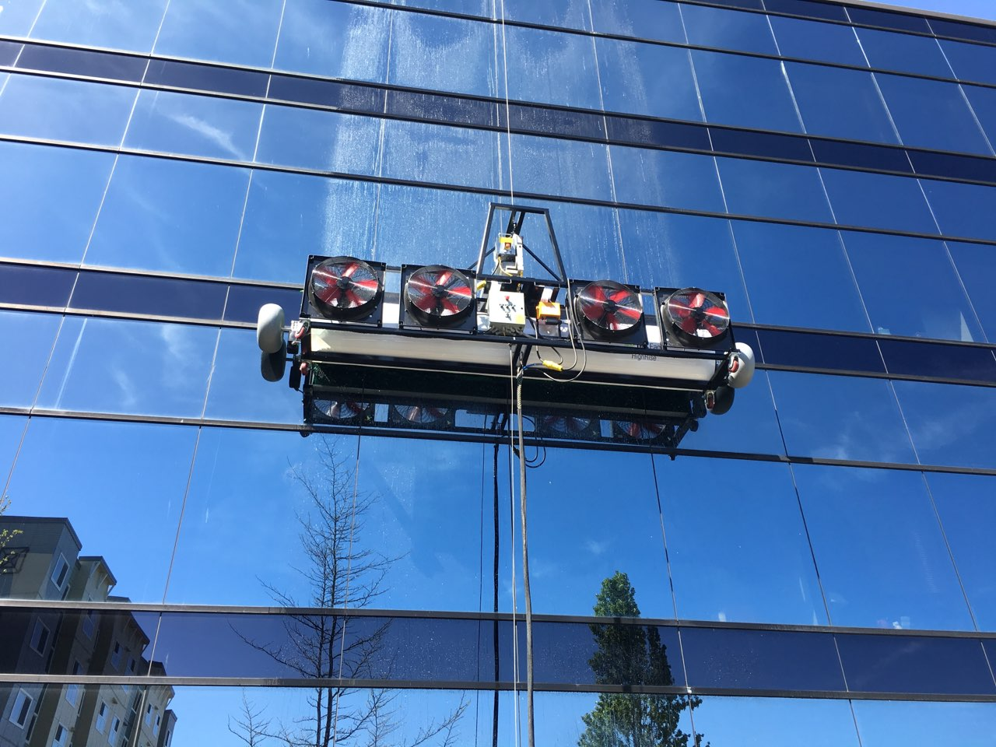
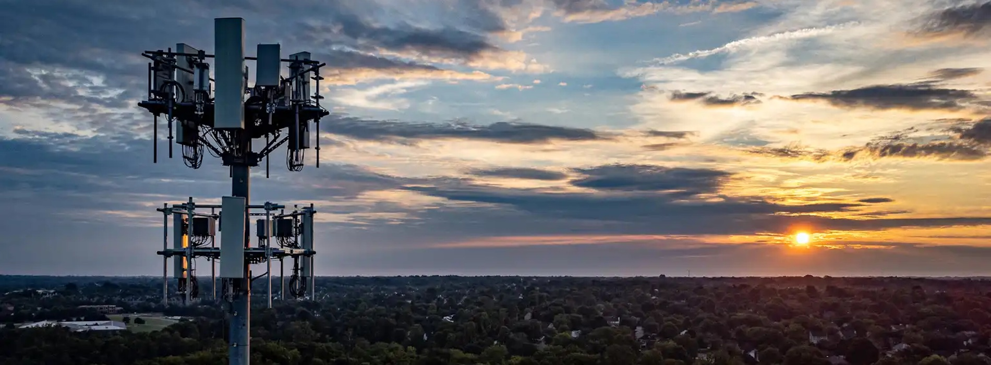
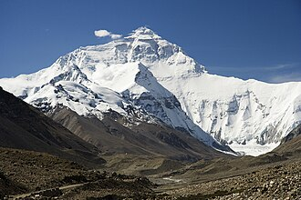
Climbing robots – Applications
For Cleaning windows of high-rise towers
To service cell phone towers
To perform rescue operations in mountains
& many more…

Slide 3
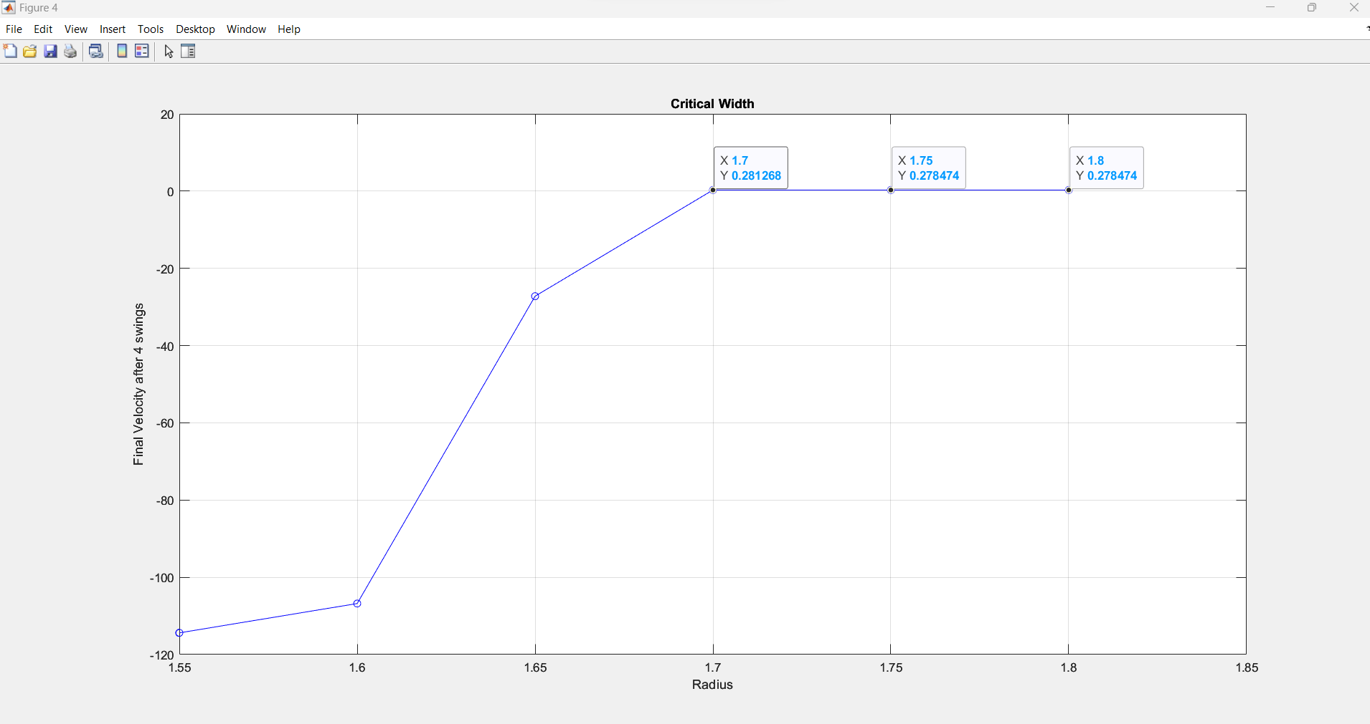
Width Vs Velocity graph
Free Body Diagram
Fy
Fx
Fy
Fx
Fy
Fx
W
From the above graph, the critical width of the verticle surface should be 3.4” (radius = 1.7”). The optimal width with a 0.05 tolerance level will be 3.5” (radius = 1.75”)

Slide 4

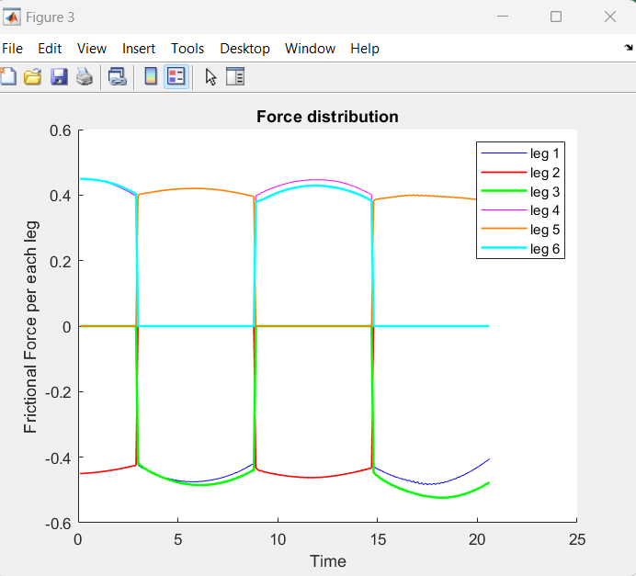
Scuttle bug moving up in the vertical direction

Slide 5
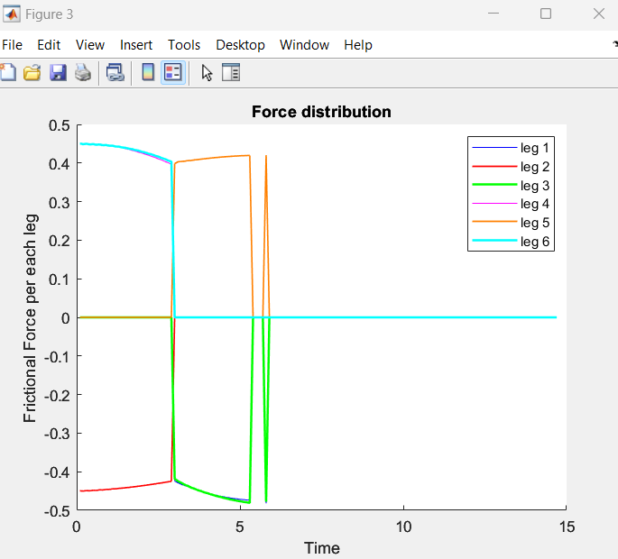
Scuttle bug falling as one of its legs is moved out of the pipe

Slide 6
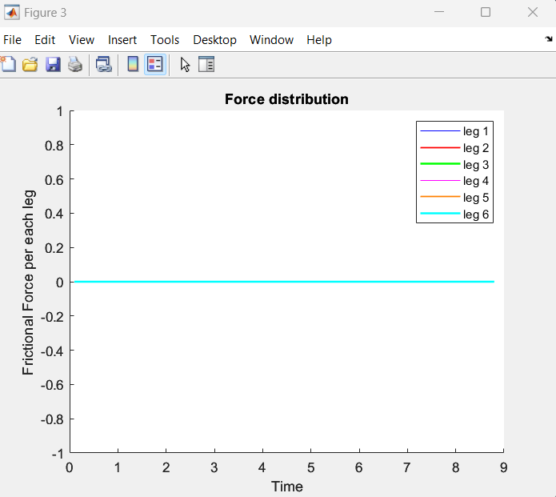
Scuttle bug falling (Width of the pipe is smaller than scuttle bug)

Slide 7
Thank You

